Slide 1
Linux Commands
LINUX COMMANDS

Slide 2
UNIX Commands
Linux Commands
A command is a program which interacts with the kernel to provide the environment and perform the functions called for by the user.
A command can be: a built-in shell command; an executable shell file, known as a shell script; or a source compiled, object code file.
The shell is a command line interpreter. The user interacts with the kernel through the shell. You can write ASCII (text) scripts to be acted upon by a shell.

Slide 3
UNIX Shell
Linux Commands
The shell sits between you and the operating system, acting as a command interpreter.
It reads your terminal input and translates the commands into actions taken by the system. The shell is analogous to command.com in DOS.
When you log into the system you are given a default shell.
When the shell starts up it reads its startup files and may set environment variables, command search paths, and command aliases, and executes any commands specified in these files.

Slide 4
UNIX Shell
Linux Commands
The original shell was the Bourne shell, sh.
Every Unix platform will either have the Bourne shell, or a Bourne compatible shell available.
The default prompt for the Bourne shell is $ (or #, for the root user).
Another popular shell is C Shell. The default prompt for the C shell is %.

Slide 5
UNIX Shell
Linux Commands
Numerous other shells are available from the network. Almost all of them are based on either sh or csh with extensions to provide job control to sh, allow in-line editing of commands, page through previously executed commands, provide command name completion and custom prompt, etc.
Some of the more well known of these may be on your favorite Unix system: the Korn shell, ksh, by David Korn and the Bourne Again SHell, bash, from the Free Software Foundations GNU project, both based on sh, the T-C shell, tcsh, and the extended C shell, cshe, both based on csh.
cat /etc/shells

Slide 6
Shell Programming
Linux Commands
You can write shell programs by creating scripts containing a series of shell commands.
The first line of the script should start with #! which indicates to the kernel that the script is directly executable.
You immediately follow this with the name of the shell, or program (spaces are allowed), to execute, using the full path name. So to set up a Bourne shell script the first line would be: #! /bin/sh

Slide 7
Shell Programming
Linux Commands
The first line is followed by commands
Within the scripts # indicates a comment from that point until the end of the line, with #! being a special case if found as the first characters of the file.
#!/bin/bash
cd /tmp
mkdir t
You also need to specify that the script is executable by setting the proper bits on the file with chmod, e.g.:
$ chmod +x shell_script
$ sh shell_script
$ ./shell_script

Slide 8
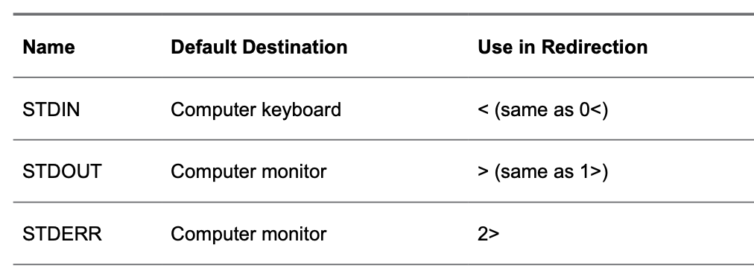
I/O Redirection
Linux Commands
By default, when a command is executed, it shows its results on the screen of the computer you are working on. The computer monitor is used as the standard destination for output, which is also referred to as the STDOUT.

Slide 9
Using Pipes
Linux Commands
A pipe can be used to catch the output of one command and use that as input for a second command. If a user runs the command ls, for instance, the output of the command is shown onscreen, because the screen is the default STDOUT. If the user uses ls | less, the commands ls and less are started in parallel. The standard output of the ls command is connected to the standard input of less. Everything that ls writes to the standard output will become available for read from standard input in less. The result is that the output of ls is shown in the less pager, where the user can browse up and down through the results easily.
As a Linux administrator, you’ll use pipes a lot. Using pipes makes Linux a flexible operating system; by combining multiple commands using pipes, you can create “super” commands that make almost anything possible.

Slide 10
Exercises - Using I/O Redirection and Pipes
Linux Commands
1. Open a shell as user user and type cd without any arguments. This ensures that the home directory of this user is the current directory while working on this exercise. Type pwd to verify this.
2. Type ls. You’ll see the results onscreen.
3. Type ls > /dev/null. This redirects the STDOUT to the null device, with the result that you will not see it.
8. Type touch output and cat output to show the contents of this file.
9. Type echo hello > output. This overwrites the contents of the output file.
10. Type ls >> output. This appends the result of the ls command to the output file.
11. Type ls -R /. This shows a long list of files and folders scrolling over your computer monitor. (You might want to press Ctrl-C to stop [or wait some time]).
12. Type ls -R | less. This shows the same result, but in the pager less, where you can scroll up and down using the arrow keys on your keyboard.
13. Type q to close less. This will also end the ls program.
14. Type ls > /dev/tty1. This gives an error message because you are executing the command as an ordinary user and ordinary users cannot address device files directly (unless you were logged in to tty1). Only the user root has permission to write to device files directly.

Slide 11
History
Linux Commands
is configured by default to keep the last 1,000 commands a user used (and if the shell session is never closed, the exact number can grow well beyond that). When a shell session is closed, the history of that session is updated to the history file. The name of this file is .bash_ history, and it is created in the home directory of the user who started a specific shell session. Notice that the history file is closed only when the shell session is closed; until that moment, all commands in the history are kept in memory.
Type history to show a list of all commands in the Bash history.
Press Ctrl-r to open the prompt from which you can do backward searches in commands that you have previously used. Just type a string and Bash will look backward in the command history for any command containing that string as the command name or one of its arguments. Press Ctrl-r again to repeat the last backward search.
Type !number to execute a command with a specific number from history.
Type !sometext to execute the last command that starts with sometext. Notice that this is a potentially dangerous command because the command that was found is executed immediately!

Slide 12
History
Linux Commands
wipe the Bash history - history -c
remove the complete Bash history - history -w immediately after using history -c
Make sure that you have opened a shell as user student.
Type history to get an overview of commands that you have previously used.
Type some commands, such as the following: ls pwd cat /etc/hosts ls -l The goal is to fill the history a bit.
Open a second terminal on your server by right-clicking the graphical desktop and selecting the Open in Terminal menu option.
Type history from this second terminal window. Notice that you do not see the commands that you just typed in the other terminal. That is because the history file has not been updated yet.
From the first terminal session, press Ctrl-r. From the prompt that opens now, type ls. You’ll see the last ls command you used. Press Ctrl-r again. You’ll now see that you are looking backward and that the previous ls command is highlighted. Press Enter to execute it.
Type history | grep cat. The grep command searches the history output for any commands that contain the text cat. Note the command number of one of the cat commands you have previously used.
Type !nn, where nn is replaced by the number you noted in step 7. You’ll see that the last cat command is repeated.
Close this terminal by typing exit.
From the remaining terminal window, type history -c. This wipes all history that is currently in memory. Close this terminal session as well.
Open a new terminal session and type history. It may be a bit unexpected, but you’ll see a list of commands anyway. That is because history -c clears the in-memory history, but it does not remove the .bash_history file in your home directory.

Slide 13
Bash Completion
Linux Commands
helps you in finding the command you need, and it also works on variables and filenames. If you have installed the bash-completion software package, it works for some of the more complex commands as well.
is useful when working with commands. Just type the beginning of a command and press the Tab key on your computer’s keyboard. If there is only one option for completion, Bash will complete the command automatically for you. If there are several options, you need to press Tab once more to get an overview of all the available options.
1. Still from a user shell, type gd and press Tab. You’ll see that nothing happens.
2. Press Tab again. Bash now shows a short list of all commands that start with the letters gd.
3. To make it clear to Bash what you want, type i (so that your prompt at this point shows the command gdi). Press Tab again. Bash now knows what you want and opens gdisk for you. Press Enter to close the prompt that was just opened.
4. Use cd /etc to go to the /etc directory.
5. Type cat pas and press Tab. Because there is one file only that starts with pas, Bash knows what to do and automatically completes the filename. Press Enter to execute the command.

Slide 14
Editing Files with vim
Linux Commands
Managing Linux often means working with files. Most things that are configured on Linux are configured through files. To complete administrative tasks, you often need to change the contents of a configuration file with a text editor.
vi is the only text editor that is always available. That is why as a Linux administrator you need to know how to work with vi. One common alternative is vim, or “vi improved”; it is a complete rewrite of vi with a lot of enhancements that make working with vi easier, such as syntax highlighting for many configuration files, which makes it easy to recognize typing errors that you have made.
vim is that it uses different modes. Two of them are particularly important: command mode and input mode.

Slide 15
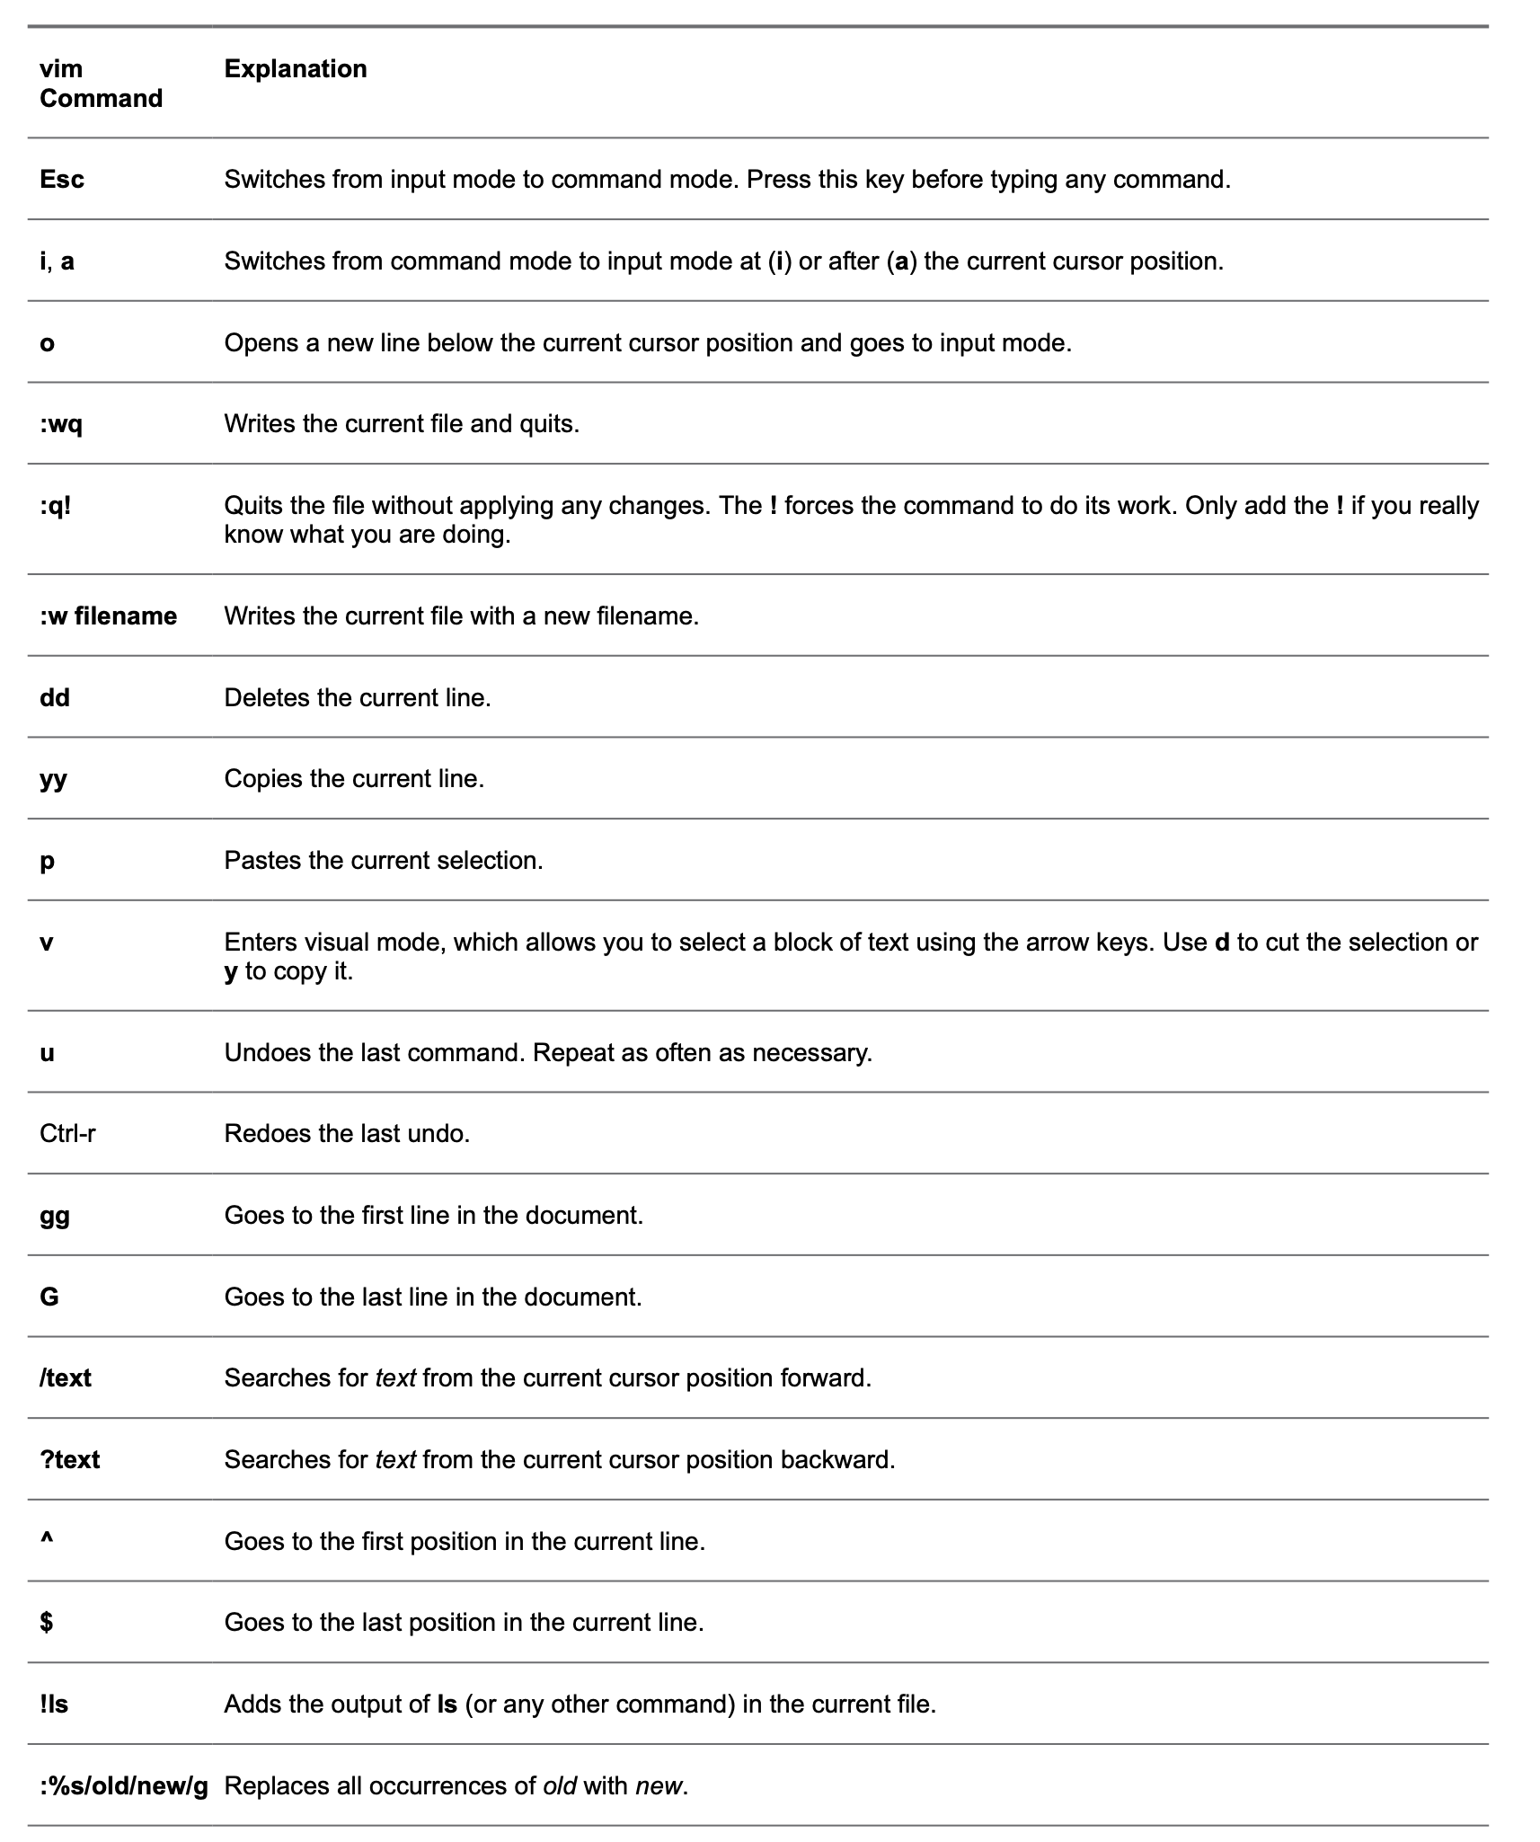
Editing Files with vim
Linux Commands

Slide 16
Editing Files with vim - ASSIGNMENT
Linux Commands
1. Type vim ~/testfile. This starts vim and opens a file with the name testfile in ~, which represents your current home directory.
2. Type i to enter input mode and then type the following text:
cow sheep ox chicken snake fish oxygen
3. Press Esc to get back to command mode and type :w to write the file using the same filename. 4. Type :3 to go to line number 3. 5. Type dd to delete this line. 6. Type dd again to delete another line.
7. Type u to undo the last deletion.
8. Type o to open a new line.
9. Enter some more text at the current cursor position:
tree farm
10. Press Esc to get back into command mode. 11. Type :%s/ox/OX/g. 12. Type :wq to write the file and quit. If for some reason that does not work, use :wq!.

Slide 17
8 Essential Vim Editor Navigation
Linux Commands
Navigation is a vital part of text editing. To be very productive, you should know of all possible navigation shortcuts in your editor.
Vim Line Navigation
k – navigate upwards
j – navigate downwards
l – navigate right side
h – navigate left side
go down by 10 lines, then type “10j”.
2. Vim Screen Navigation
H – Go to the first line of current screen.
M – Go to the middle line of current screen.
L – Go to the last line of current screen.
ctrl+f – Jump forward one full screen.
ctrl+b – Jump backwards one full screen
ctrl+d – Jump forward (down) a half screen
ctrl+u – Jump back (up) one half screen

Slide 18
8 Essential Vim Editor Navigation
Linux Commands
Navigation is a vital part of text editing. To be very productive, you should be aware of all possible navigation shortcuts in your editor. 3. Vim Special Navigation
N% – Go to the Nth percentage line of the file.
NG – Go to the Nth line of the file.
G – Go to the end of the file.
`” – Go to the position where you were in NORMAL MODE while last closing the file.
`^ – Go to the position where you were in INSERT MODE while last closing the file.
g – Go to the beginning of the file.
4. Vim Word Navigation
e – go to the end of the current word.
E – go to the end of the current WORD.
b – go to the previous (before) word.
B – go to the previous (before) WORD.
w – go to the next word.
W – go to the next WORD.

Slide 19
8 Essential Vim Editor Navigation
Linux Commands
Navigation is a vital part of text editing. To be very productive, you should be aware of all possible navigation shortcuts in your editor.
5. Vim Paragraph Navigation
{ – Go to the beginning of the current paragraph. By pressing { again and again move to the previous paragraph beginnings.
} – Go to the end of the current paragraph. By pressing } again and again move to the next paragraph end, and again.

Slide 20
8 Essential Vim Editor Navigation
Linux Commands
Navigation is a vital part of text editing. To be very productive, you should be aware of all possible navigation shortcuts in your editor. 6. Vim Search Navigation
/i – Search for a pattern which will you take you to the next occurrence of it.
?i – Search for a pattern which will you take you to the previous occurrence of it.
* – Go to the next occurrence of the current word under the cursor.
# – Go to the previous occurrence of the current word under the cursor.
7. Vim Code Navigation
% – Go to the matching braces, or parenthesis inside code.
8. Vim Navigation from Command Line
Vim +N filename: Go to the Nth line of the file after opening it.
vim +10 /etc/passwd

Slide 21
Vi and Vim Editor: 8 Powerful Find and Replace Examples
Linux Commands
Syntax of the text substitution inside vim editor:
:[range]s[ubstitute]/{pattern}/{string}/[flags] [count]
Three possible flags: [c] Confirm each substitution. [g] Replace all occurrences in the line. [i] Ignore case for the pattern.
Substitute all occurrences of a text with another text in the whole file:
:%s/old-text/new-text/g
2. Substitution of a text with another text within a single line
:s/I/We/gi
3. Substitution of a text with another text within a range of lines
:1,10s/helo/hello/g
4. Substitution of a text with another text by visual selection of lines
:'<,'>s/helo/hello/g

Slide 22
Vi and Vim Editor: 8 Powerful Find and Replace Examples
Linux Commands
5. Substitution of a text with another text only the 1st X number of lines
:s/helo/hello/g 4
6. Substitute only the whole word and not partial match
:%s/\<his\>/her/g
7. Interactive Find and Replace in Vim Editor
:%s/awesome/wonderful/gc
8. Substituting all lines with its line number.
:%s/^/\=line(".") . ". "/g

Slide 23
Quiz
Linux Commands
1. You are looking for a variable that is set in a Bash login shell for all users. Which of the following files is the most likely location where this variable is set? (Choose two.) a. /etc/profile b. /etc/basic c. ~/.bash_profile d. ~/.bashrc
2. A user has created a script with the name myscript. He tries to run it using the command myscript, but it is not started. The user has verified that the script permissions are set as executable. Which of the following is the most likely explanation? a. An internal command is preventing the startup of the script. b. Users are not allowed to run scripts. c. The directory that contains the script is not in the PATH. d. The script does not have appropriate permissions.
3. You need the output of the command ls to be used as input for the less command. Which of the following examples will do that for you? a. ls > less b. ls >> less c. ls >| less d. ls | less
Notes:
A and C. /etc/profile is the file that is processed for all users who are starting a login shell. A user-specific version exists as well, with the name ~/.bash_profile.
C. On Linux, the current directory is not set in the PATH variable.
D. A pipe is used to process the output of the first command and use it as input of the second command.

Slide 24
Quiz
Linux Commands
4. A user wants to remove her complete history. Which of the following approaches would do that? a. Remove the ~/.bash_history file and type history -c. b. Type history -c. c. Remove the ~/.bash_history file. d. Type history -c and close the current shell.
5. Which of the following is not a valid method to repeat a command from history? a. Press Ctrl-r and start typing a part of the command. b. Type ! followed by the first letters in the command. c. Type ! followed by the number of the command as listed in history. d. Press Ctrl-x followed by the number in history.
6. For which of the following items can Bash completion be used? a. Commands b. Files c. Variables d. All of the above
7. Which of the following commands enables you to replace every occurrence of old with new in a text file that is opened with vi? a. :%s/old/new/g b. :%r/old/new/ c. :s/old/new/g d. r:/old/new
Notes:
4. A. The command history -c removes the in-memory state from the history file of current history. Remove ~/.bash_history also to make sure that all history is removed. As an alternative to removing the .bash_history file, the user can type history -c, followed by history -w.
5. D. Ctrl-X is not a valid history command.
6. D. Bash completion works for commands, files, variables and other names if configuration for that has been added (like hostnames for
the SSH command).
7. A. You need the command :%s/old/new/g to replace all instances of old with new. % means that it must be applied on the entire file. s stands for substitute. The g option is used to apply the command to not only the first occurrence in a line (which is the default behavior) but all occurrences in the line.

Slide 25
Quiz
Linux Commands
8. Which approach works best if during the login process you want to show a message to all users who have just logged in to a shell session on your server? a. Put the message in /etc/issue. b. Put the message in /etc/motd. c. Put the message in /etc/profile. d. Put the message in /etc/bashrc.
9. You are using man -k user, but you get the message “nothing appropriate.” Which of the following solutions is most likely to fix this for you? a. Type updatedb to update the mandb database. b. Type makewhatis to update the mandb database. c. Type mandb to update the mandb database. d. Use man -K, not man -k
Notes:
8. B. The /etc/motd file contains messages that are displayed after user login on a terminal session. If you want to show a message before users log in, edit the /etc/issue file.
9. C. The man -k command uses a database to find the keywords you are looking for. On RHEL 8, this database is updated with the mandb command. On older versions of RHEL (prior to RHEL 7), the makewhatis command was used instead.

Slide 26
LINUX COMMANDS
Linux Commands
File Management and Viewing
Filesystem Management
Help, Job and Process Management
Network Management
System Management
User Management
Printing and Programming
Document Preparation
Miscellaneous

Slide 27
Command Structure
Linux Commands
Command <Options> <Arguments>
Multiple commands separated by ; can be executed one after the other

Slide 28
Help Facilities for Commands
Linux Commands
To understand the working of the command and possible options use (man command)
Using the GNU Info System (info, info command)
Listing a Description of a Program (whatis command)
apropos network (update manual pages - mandb)
Many tools have a long−style option, `−−help', that outputs usage information about the tool, including the options and arguments the tool takes. Ex: whoami —help
/usr/share/doc Documentation Files - useful for services and larger systems that are a bit more complicated. (links/lynx - repository/subscription-manager)

Slide 29
Pipes
Linux Commands
An important early development in Unix was the invention of "pipes," a way to pass the output of one tool to the input of another.
eg. $ who | wc −l
By combining these two tools, giving the wc command the output of who, you can build a new command to list the number of users currently on the system

Slide 30
Linux File Management and Viewing
Linux Commands
File and Directory management
cd Change the current directory. With no arguments "cd" changes to the users home directory. (cd <directory path>)
chmod Change the file permissions.
Ex: chmod 751 myfile : change the file permissions to rwx for owner, rx for group and x for others
Ex: chmod go=+r myfile : Add read permission for the group and others (character meanings u-user, g-group, o-other, + add permission,-remove,r-read,w-write,x-execute) Ex: chmod +s myfile - Setuid bit on the file which allows the program to run with user or group privileges of the file.

Slide 31
Linux File Management and Viewing
Linux Commands
There are three such special permissions within Linux. They are:
setuid — used only for applications, this permission indicates that the application is to run as the owner of the file and not as the user executing the application. It is indicated by the character s in place of the x in the owner category. If the owner of the file does not have execute permissions, the S is capitalized to reflect this fact.
setgid — used primarily for applications, this permission indicates that the application is to run as the group owning the file and not as the group of the user executing the application. The setgid permission is indicated by the character s in place of the x in the group category. If the group owner of the file or directory does not have execute permissions, the S is capitalized to reflect this fact.
sticky bit — used primarily on directories, this bit dictates that a file created in the directory can be removed only by the user that created the file. It is indicated by the character t in place of the x in the everyone category. If the everyone category does not have execute permissions, the T is capitalized to reflect this fact.

Slide 32
Linux File Management and Viewing
Linux Commands
chown Change owner.
Ex: chown <owner1> <filename> : Change ownership of a file to owner1.
chgrp Change group.
Ex: chgrp <group1> <filename> : Change group of a file to group1.
cp Copy a file from one location to another.
Ex: cp file1 file2 : Copy file1 to file2
Ex: cp –R dir1 dir2 : Copy dir1 to dir2
Ex: cp –a dir1 . : Copy dir1 to ., keep the current permissions
md5sum Prints the MD5 Checksum

Slide 33
Linux File Management and Viewing
Linux Commands
ls List contents of a directory.
Ex: ls, ls –l , ls –al, ls –ld, ls –R, ls -lrt
(-rwxrwxr-x 1 juan juan 0 Sep 26 12:25 foo )
|more will list page wise
mkdir Make a directory.
Ex: mkdir <directory name> : Makes a directory
Ex mkdir –p /www/cache/var/log will create all the directories starting from www.
mv Move or rename a file or directory.
Ex: mv <source> <destination>

Slide 34
Linux File Management and Viewing
Linux Commands
find Find files (find <start directory> -name <file name> -print)
Ex: find /home –name readme -print
(Search for readme starting at home and output full path.) “/home" = Search starting at the home directory and proceed through all its subdirectories
"-name readme" = Search for a file named readme
"-print" = Output the full path to that file
locate File locating program that uses the slocate database.
Ex: locate –u to create the database, / updatedb
locate <file/directory> to find file/directory

Slide 35
Linux File Management and Viewing
Linux Commands
pwd Print or list the present working directory with full path.
rm Delete files (Remove files). (rm –rf <directory/file>)
rmdir Remove a directory. The directory must be empty. (rmdir <directory>)
touch Change file timestamps to the current time. Make the file if it doesn't exist. (touch <filename>)
whereis Locate the binary and man page files for a command. (whereis <program/command>)
which Show full path of commands where given commands reside. (which <command>)

Slide 36
Linux File Management and Viewing
Linux Commands
File viewing and editing
emacs Full screen editor.
nano Simple text editor.
vi Editor with a command mode and text mode. Starts in command mode.
gedit GUI Text Editor
tail Look at the last 10 lines of a file.
Ex: tail –f <filename> ,
Ex: tail -100 <filename>
head Look at the first 10 lines of a file. (head <filename>)
cat Dumps the contents of the text file on the screen
less Opens the text file in a pager, which allows for easy reading
cut Used to filter specific columns or characters from a text file
sort Sorts the contents of a text file
wc Counts the number of lines, words, and characters in a file

Slide 37
Linux File Management and Viewing
Linux Commands
Examples
1. Type tail -f /var/log/messages. You’ll see the last lines of /var/log/messages being displayed. The file doesn’t close automatically. 2. Press Ctrl-C to quit the previous command. 3. Type head -n 5 /etc/passwd to show the first five lines in /etc/passwd. 4. Type tail -n 2 /etc/passwd to show the last two lines of /etc/passwd. 5. Type head -n 5 /etc/passwd | tail -n 1 to show only line number 5 of the /etc/passwd file. 6. Type cut -d : -f 1 /etc/passwd to filter out the first field of the /etc/passwd file 7. Type cut -f 2 -d : /etc/passwd | sort -n to sort the second field of the /etc/passwd file in numeric order. 8. Type sort - k1 -t : /etc/passwd to sort the first column of the /etc/passwd file. 9. Type ps aux | tail -n 10 to find the busiest processes on a linux server 10 Type ps aux | wc to counting the number of lines, words, and characters

Slide 38
Linux File Management and Viewing
Linux Commands
File compression, backing up and restoring
compress Compress data.
uncompress Expand data.
cpio Can store files on tapes. to/from archives.
gzip - zip a file to a gz file.
gunzip - unzip a gz file.
tar Archives files and directories. Can store files and directories on tapes.
Ex: tar -zcvf <destination> <files/directories> - Archive copy groups of files. tar –zxvf <compressed file> to uncompress Ex: tar -rvf /root/homes.tar /etc/hosts - add a file to an existing archive or to update an archive. Ex: tar -uvf /root/homes.tar /home - update a currently existing archive file

Slide 39
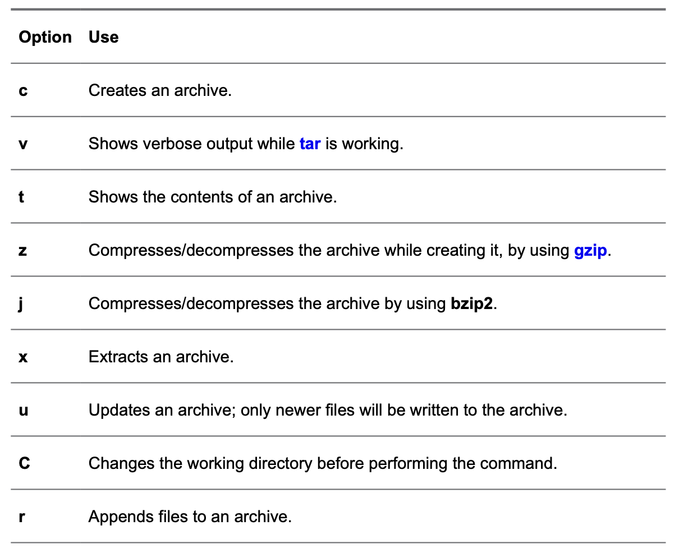
Linux File Management and Viewing
Linux Commands
Overview of tar Options

Slide 40
Linux File Management and Viewing
Linux Commands
Exercise Using tar
1. Open a root shell on your server. By logging in, the home directory of user root will become the current directory, so all relative filenames used in this exercise refer to /root/.
2. Type tar -cvf logs.tar /var/log to archive the contents of the /var/log directory.
3. Type file logs.tar and read the information that is provided by the command. This should
look like the following:
[root@server1 ~]# file logs.tar etc. tar: POSIX tar archive (GNU)
4. Type gzip logs.tar.
5. Type tar tvf logs.tar.gz. Notice that the tar command has no issues reading from a gzip compressed file. Also notice that the archive content consists of all relative filenames.
6. Type tar xvf logs.tar.gz log/cron.
7. Type ls -R. Notice that a subdirectory logs has been created in the current directory. In this subdirectory, the file hosts has been restored.
8. Type gunzip logs.tar.gz. This decompresses the compressed file but does not change anything else with regard to the tar command.
9. Type tar xvf logs.tar -C /tmp log/maillog. This extracts the password file to the /tmp directory.
10. Type tar cjvf homes.tar /home. This creates a compressed archive of the home directory to the home directory of user root.
11. Type rm -f *gz *tar to remove all files resulting from exercises from the home directory of /root.

Slide 41
Linux File Management and Viewing
Linux Commands
zip – Compresses a file to a .zip file.
unzip – Uncompresses a file with .zip extension.
cat View a file
Ex: cat filename
cmp Compare two files.
cut Remove sections from each line of files.
diff Show the differences between files.
Ex: diff file1 file2 : Find differences between file1 & file2.
echo Display a line of text.

Slide 42
Linux File Management and Viewing
Linux Commands
grep List all files with the specified expression. (grep pattern <filename/directorypath>) Ex: ls –l /etc|grep net : List all lines with a net in them.
Ex: grep " R " : Search for R with a space on each side
sleep Delay for a specified amount of time.
sort Sort a file alphabetically.
uniq Remove duplicate lines from a sorted file.
wc Count lines, words, characters in a file. (wc –c/w/l <filename>).

Slide 43
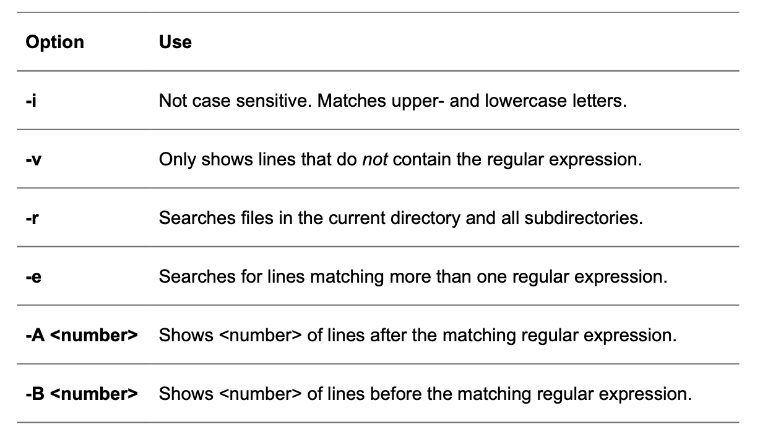
Linux File Management and Viewing
Linux Commands
Using Regular Expressions
tail -n 6 /etc/passwd|grep tcp
grep sys /etc/passwd
grep ^sys /etc/passwd (lines that start with the text
grep se$ /etc/passwd (lines that end with the text
Using grep to Analyze Text
1. Type grep '^#' /etc/sysconfig/sshd. This shows that the file /etc/sysconfig/sshd contains a number of lines that start with the comment sign, #. 2. To view the configuration lines that really matter, type grep -v '^#' /etc/sysconfig/sshd. This shows only lines that do not start with a #.
3. Type grep -v '^#' /etc/sysconfig/sshd -B 5. This shows lines that do not start with a # sign but also the five lines that are directly before each of those lines, which is useful because in the preceding lines you’ll typically find comments on how to use the specific parameters; also see that many blank lines are displayed.
4. Type grep -v -e '^#' -e '^$' /etc/sysconfig/sshd. This excludes all blank lines and lines that start with #.

Slide 44
Linux File Management and Viewing
Linux Commands
Other Useful Text Processing Utilities
awk utility is more successful in distinguishing the fields that are used in command output of files
awk -F : '{ print $4 }' /etc/passwd (shows the fourth field from /etc/passwd )
awk -F : '/user/ { print $1 }' /etc/passwd (searches the /etc/passwd file for the text user and will print the fourth field of any matching line)
sed utility is a very powerful utility for filtering text from text files (like grep), but it has the benefit that it also allows you to apply modifications to text files
sed -n 5p /etc/passwd (print the fifth line from the /etc/passwd file)
sed -i s/old-text/new-text/g ~/myfile () (search for the text old-text in ~/myfile and replace all occurrences with the text new-text)
sed -i -e '2d' ~/myfile (delete a line based on a specific line number)
sed -i -e '2d;20,25d' ~/myfile (delete lines 2 and 20 through 25)

Slide 45
Linux File Management and Viewing
Linux Commands
Using Links
Linux stores administrative data about files in inodes. The inode is used to store all administrative data about files. Every file on Linux has an inode, and in the inode, important information about the file is stored:
The data block where the file contents are stored
The creation, access, and modification date
Permissions
File owners
symbolic link (also referred to as soft link) does not link directly to the inode but to the name of the file.

Slide 46
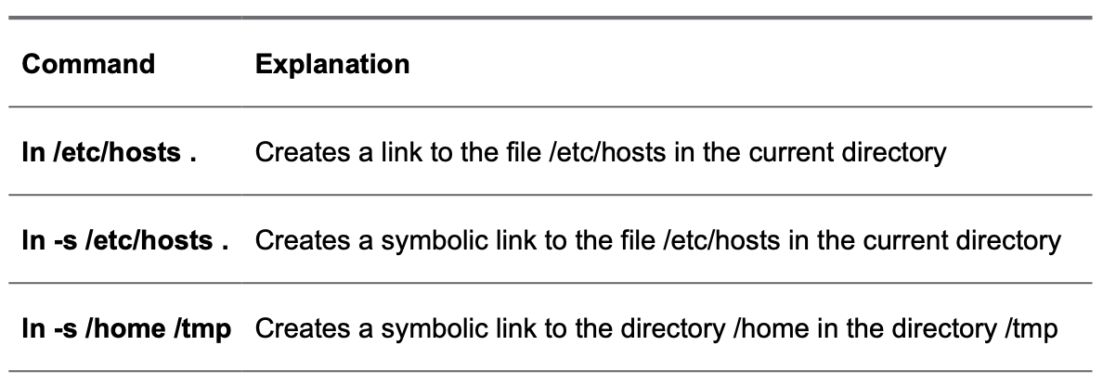
Linux File Management and Viewing
Linux Commands
Creating Links
Use the ln command to create link - to create a symbolic link, you use the option -s
Removing Links
Type rm link. This removes the link. (Do not use -r or -f to remove links, even if they are subdirectories.)

Slide 47
QUIZ
Linux Commands
1. Under which directory would you expect to find nonessential program files?
a. /boot b. /bin
c. /sbin
d. /usr
2. Under which directory would you expect to find log files?
a. /proc b. /run
c. /var
d. /usr
3. Which of the following directories would typically not be mounted on its own dedicated device?
a. /etc b. /boot
c. /home
d. /usr
4. Which of the following commands would give the most accurate overview of mounted disk devices (without showing much information about mounted system devices as well)? a. mount b. mount -a
c. df -hT d. du -h
Notes:
1. D. Program files that are not required to boot a system are typically stored in a subdirectory below the /usr directory. In old versions of RHEL, essential binaries and system binaries were stored in /bin and /sbin, but on modern versions of RHEL, these directories are a symbolic link to /usr/bin and /usr/sbin.
2. C. The /var directory is used on Linux to store files that may grow unexpectedly.
3. A. The /etc/ directory contains configuration files that are needed while your server boots. Putting /etc on a dedicated device would make your server unbootable.
4. C. The df -h command shows mounted devices and the amount of disk space currently in use on these devices. The -T option helps in recognizing real file systems (as opposed to kernel interfaces) because it shows the file system type as well.

Slide 48
QUIZ
Linux Commands
5. Which command enables you to show all files in the current directory so that the newest files are listed last? a. ls -lRt
b. ls -lrt
c. ls -alrt
d. ls -alr
6. Which command enables you to copy hidden files as well as regular files from /home/$USER to the current directory? a. cp -a /home/$USER .
b. cp -a /home/$USER/* .
c. cp -a /home/$USER/. .
d. cp -a home/$USER. .
7. Which command enables you to rename the file myfile to mynewfile?
a. mv myfile mynewfile b. rm myfile mynewfile c. rn myfile mynewfile
d. ren myfile mynewfile
8. Which statement about hard links is not true? a. Hard links cannot be created to directories. b. Hard links cannot refer to files on other devices. c. The inode keeps a hard link counter. d. If the original hard link is removed, all other hard links become invalid.
9. Which command creates a symbolic link to the directory /home in the directory /tmp?
a. ln /tmp /home b. ln /home /tmp c. ln -s /home /tmp
d. ln -s /tmp /home
10. Which tar option enables you to add one single file to a tar archive?
a. -a
b. -A
c. -r
d. -u
Notes:
5. C. The option -a shows hidden files, -l gives a long listing, -t sorts on modification time, which by default shows newest files first, and -r reverts the sorting so that newest files are shown last.
6. C. To copy hidden files as well as regular files, you need to put a . after the name of the directory the files are in. Answer A copies hidden files as well, but it creates a subdirectory $USER in the current directory.
7. A. The mv command enables you to move files and rename files.
8. D. In hard links, no difference exists between the first hard link and subsequent hard links.
9. C. The option -s is used to create a symbolic link. While creating a link, you first have to specify the source, and next you specify the destination.
10. C. Use the option -r to add one single file to an archive you have created with tar.

Slide 49
QUIZ2
Linux Commands
1. Which command was developed to show only the first ten lines in a text file?
a. head b. top
c. first d. cat
2. Which command enables you to count the number of words in a text file? a. count b. list c. ls -l d. wc
3. Which key on your keyboard do you use in less to go to the last line of the current text file? a. End b. Page Down c. q d. G
4. Which option is missing (...) from the following command, assuming that you want to filter the first field out of the /etc/passwd file and assuming that the character that is used as the field delimiter is a :? cut ... : -f 1 /etc/passwd
a. -d
b. -c
c. -t
d. -x
5. Which option is missing (...) if you want to sort the third column of the output of the command ps aux? ps aux | sort ... a. -k3
b. -s3 c. -k f 3 d. -f 3
Notes:
1. A. The head command by default shows the first ten lines in a text file.
2. D. The wc command shows the number of lines, words, and characters in a file.
3. D. When using less, the G key brings you to the end of the current file.
4. A. The -d option is used to specify the field delimiter that needs to be used to distinguish different fields in files while using cut.
5. A. The sort command can sort files or command output based on specific keys. If no specific key is mentioned, sorting happens based on fields. The option -k3 will therefore sort the third field in the output of the ps aux command.

Slide 50
QUIZ2
Linux Commands
6. Which of the following commands would only show lines in the file /etc/passwd that start with the text anna? a. grep anna /etc/passwd b. grep -v anna /etc/passwd
c. grep $anna /etc/passwd
d. grep ^anna /etc/passwd
7. Which regular expression do you use to make the previous character optional?
?
b. .
c. *
d. &
8. Which regular expression is used as a wildcard to refer to any single character?
a. ? b. . c. * d. &
9. Which command prints the fourth field of a line in the /etc/passwd file if the text user occurs in that line?
a. awk '/user/ { print $4 }' /etc/passwd b. awk -d : '/user/ { print $4 }' /etc/passwd c. awk -F : '/user/ $4' /etc/passwd d. awk -F : '/user/ { print $4 }' /etc/passwd
10. Which option would you use with grep to show only lines that do not contain the regular expression that was used?
a. -x b. -v c. -u d. -q
Notes:
6. D. When used in a regular expression, the ^ sign in front of the text you are looking for indicates that the text has to be at the beginning of the line.
7. A. The ? regular expression is used to refer to zero or one of the previous characters. This makes the previous character optional, which can be useful. If the regular expression is colou?r, for example, you would get a match on color as well as colour.
8. B. The . is used as a regular expression to refer to any single character.
9. D. The awk command first needs to know which field separator should be used. This is specified with the -F : option. Then, it needs to specify a string that it should look for, which is /user/. To indicate that the fourth field of a matching file should be printed, you need to include the { print $4 } command.
10. B. Use grep -v to exclude from the results lines containing the regular expression.

Slide 51
ASSIGNMENT
Linux Commands
Login as student (password is student)
Open Terminal and find out the shell you are using.
Change your shell to sh
Write a shell script (using vi editor) to create a directory test in your area and copy the contents of /etc in test directory.
Move the contents of test directory in test1 directory
Copy the test1 directory in /tmp
Write, the date of Creation/Modification, ownership, group and permissions of test1 directory
Tar and gzip the contents of test1.
Move the test1.tgz into your area and Untar it
Write the names of all the files in test1 directory and its subdirectories which have as in their name into a file asname (ls -al test1 > /tmp/asname)
Delete the test1 directory using rm command and see if you find it in Trash
Use find command and locate command to find the location of passwd command
Find out the number of commands in /bin
Create a command to create new users (Use useradd command. See the man page of useradd for command options). Use chmod to give it appropriate permission so that only student user can run this command
Compute the MD5 Checksum of kernel file

